Slide 1
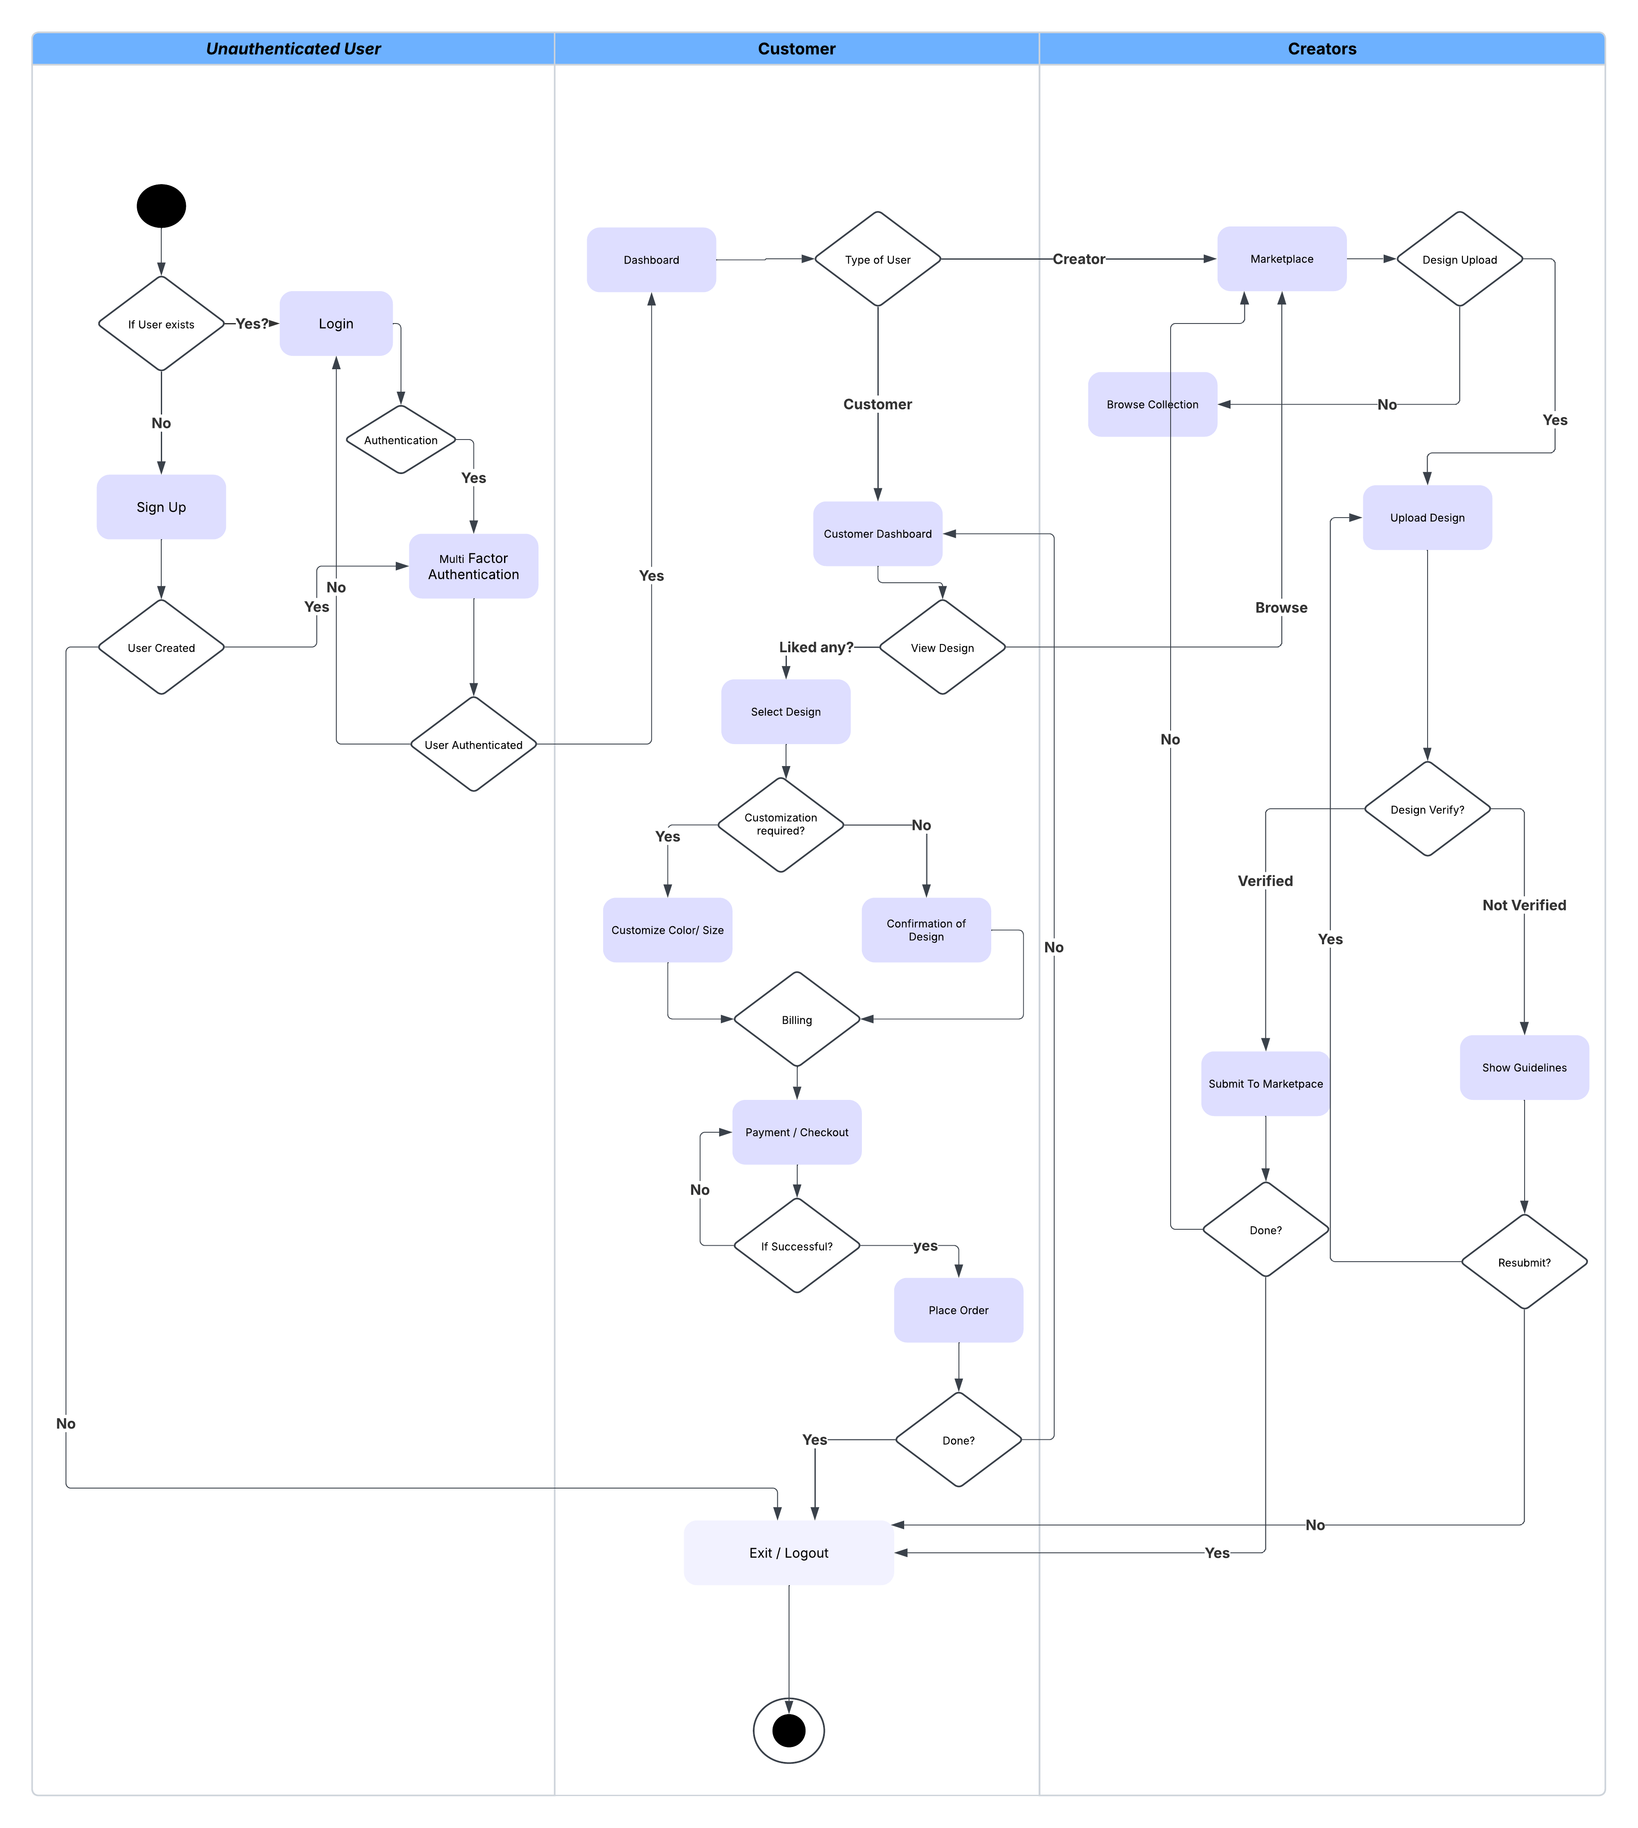
CustomThreads (Activity Diagram)

